Slide 1

Southey Capital
Illiquid and Distressed
Secondary markets and Transaction services
Information for holders of:
SNS Bank / Stichting AOS
XS0552743048
STRICTLY PRIVATE & CONFIDENTIAL
2021

Slide 2
Security of interest
  Issue Description
  Issuer: STICHTING AOS
  Bond Information SNSBNK 6.25 10/26/20 EMTN
  ISIN: XS0552743048
  FIGI: BBG0017VM701
  Country: NE
  Currency: EUR
  Coupon: 6.25
  Typr: EURO MTN
  Amount Issued: 500,000,000
  Minimum Increment: 1000
  Pricing Date: 19/10/2010

Slide 3
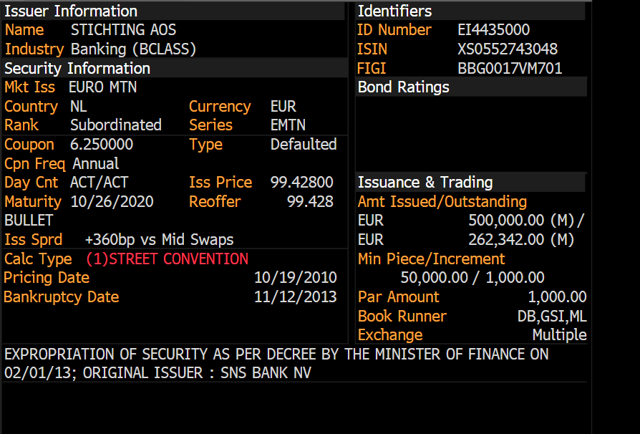
SNS Bank / Stichting AOS XS0552743048

Slide 4
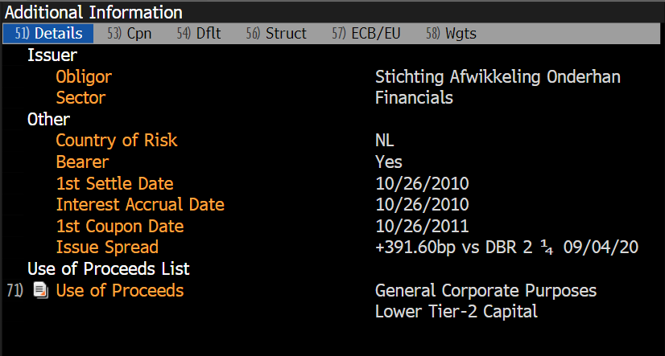
Additional Details on XS0552743048

Slide 5
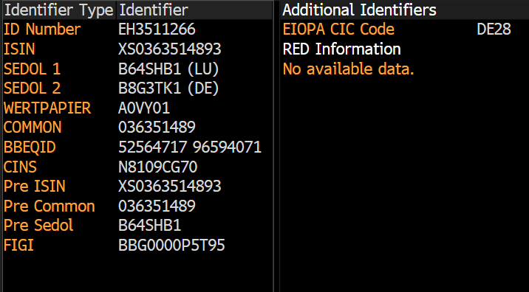
Additional Identifiers
ID Number
ISIN: XS0552743048
SEDOL 1: B59CTB5
Wertpapier: A1A2YG
Common: 055274304
Pre ISIN: XS0552743048
Pre Common: 055274304
Pre Sedol:
CINS: N8109C2A8

Slide 6
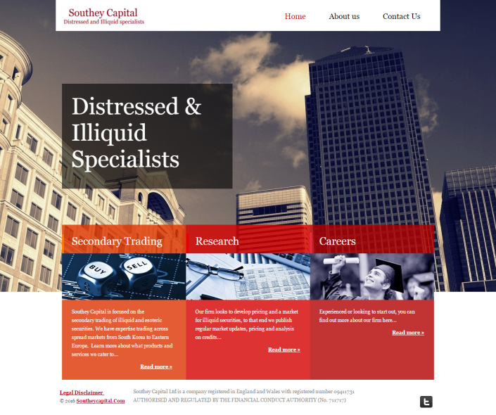
Contact Details
Address:
Southey Capital Ltd
Ensign House, Admirals Way
London, E14 9XQ
United Kingdom
Tel. : +44 203 745 7940
Email: info@southeycapital.com
utheycapital.com
Web: www.southeycapital.com/en/Contact-Us/
Twitter: twitter.com/southeycapital

Slide 7
Confidentiality Statement
The information and opinions contained in this presentation are for background purposes only, do not purport to be full or complete and do not constitute investment advice. No reliance may be placed, for any purpose, on the information and opinions contained in this presentation or their accuracy or completeness. No representation, warranty or undertaking, express or implied, is given as to the accuracy or completeness of the information or opinions contained in this presentation by either of the Southey Capital Ltd or by their respective directors, officers, partners, shareholders, employees or affiliates and no liability is accepted by any such persons for the accuracy or completeness of any such information or opinions.
The traded amounts, credits and other deal experience includes colleagues experience at previous employers.
The material contained in this presentation is based upon proprietary information and is provided purely for reference and, as such, is confidential and intended for private use only. The text and statistical data, or any portion thereof, contained in this presentation may not be stored in a computer, published, rewritten for broadcast or publication or redistributed in any medium, except with the express written permission of the Southey Capital Ltd.

